Slide 1
Web Scrapping Mission to Mars
Kent Rodgers
December 8, 2020

Slide 2
Key Deliverables – Step One
Step One: Four “Scrapes” from the following:
NASA Mars News
Reference the NASA Mars News Site at (https://mars.nasa.gov/news/)
The latest News Title and Paragraph Text is collected
The text is converted to variables and inserted into a MongoDB dictionary that are referenced later
JPL Mars Space Images - Featured Image
The JPL Featured Space Image at (https://www.jpl.nasa.gov/spaceimages/?search=&category=Mars.) is referenced for a changing image to be utilized as the feature image
Splinter is utilized to navigate the site and find the image url for the current Featured Mars Image and assign the url string to a variable called `featured_image_url`.
The full size `.jpg` image is utilized
The imaged is converted to variables and inserted into a MongoDB dictionary that are referenced later
Mars Facts
The Mars Facts webpage at (https://space-facts.com/mars/) is used to collect a table containing facts about the planet. Pandas is utilized to scrape the table containing facts about the planet including Diameter, Mass, etc.
Pandas is utilized to convert the data to a HTML table string to be referenced later
Mars Hemispheres
The USGS Astrogeology site at (https://astrogeology.usgs.gov/search/results?q=hemisphere+enhanced&k1=target&v1=Mars) is referenced to obtain high resolution images for each of Mar's hemispheres.
A script was created that clicks each of the links to the hemispheres in order to find the image url to the full resolution image.
Both an image url string for the full resolution hemisphere image, and the Hemisphere title containing the hemisphere name are stored as a list of dictionaries in MongoDB to be referenced later.

Slide 3
Key Deliverables – Step Two
Step Two: Deliver the scrapped information via an HTML page
MongoDB and Flask templating were used to create a new HTML page that displays all of the information that was scraped from the URLs above.
Jupyter notebook was utilized to plan and test the Python script called `scrape_mars.py`.
A function was created in Visual Studio to execute all of the scraping code from above and return one Python dictionary in MongoDB containing all of the scraped data.
A route called `/scrape` that imports the `scrape_mars.py` script and calls the `scrape` function was crated in app.py to enable the application.
Scraped text, tables and images are saved to Mongo as a Python dictionary.
A main route `/` queries the Mongo database and passes the mars data into an HTML template to display the data to the end consumer.
An HTML template file called `index.html` takes the mars data dictionary and display all of the data in the appropriate HTML elements.

Slide 4
HTML Page Screen Shots

Slide 5
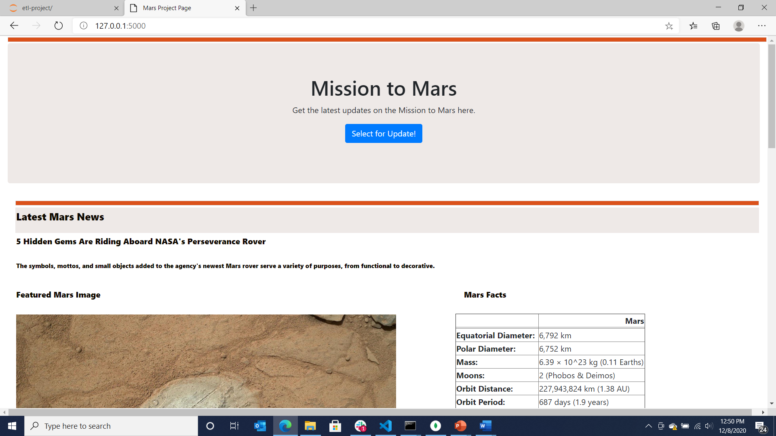

Slide 6
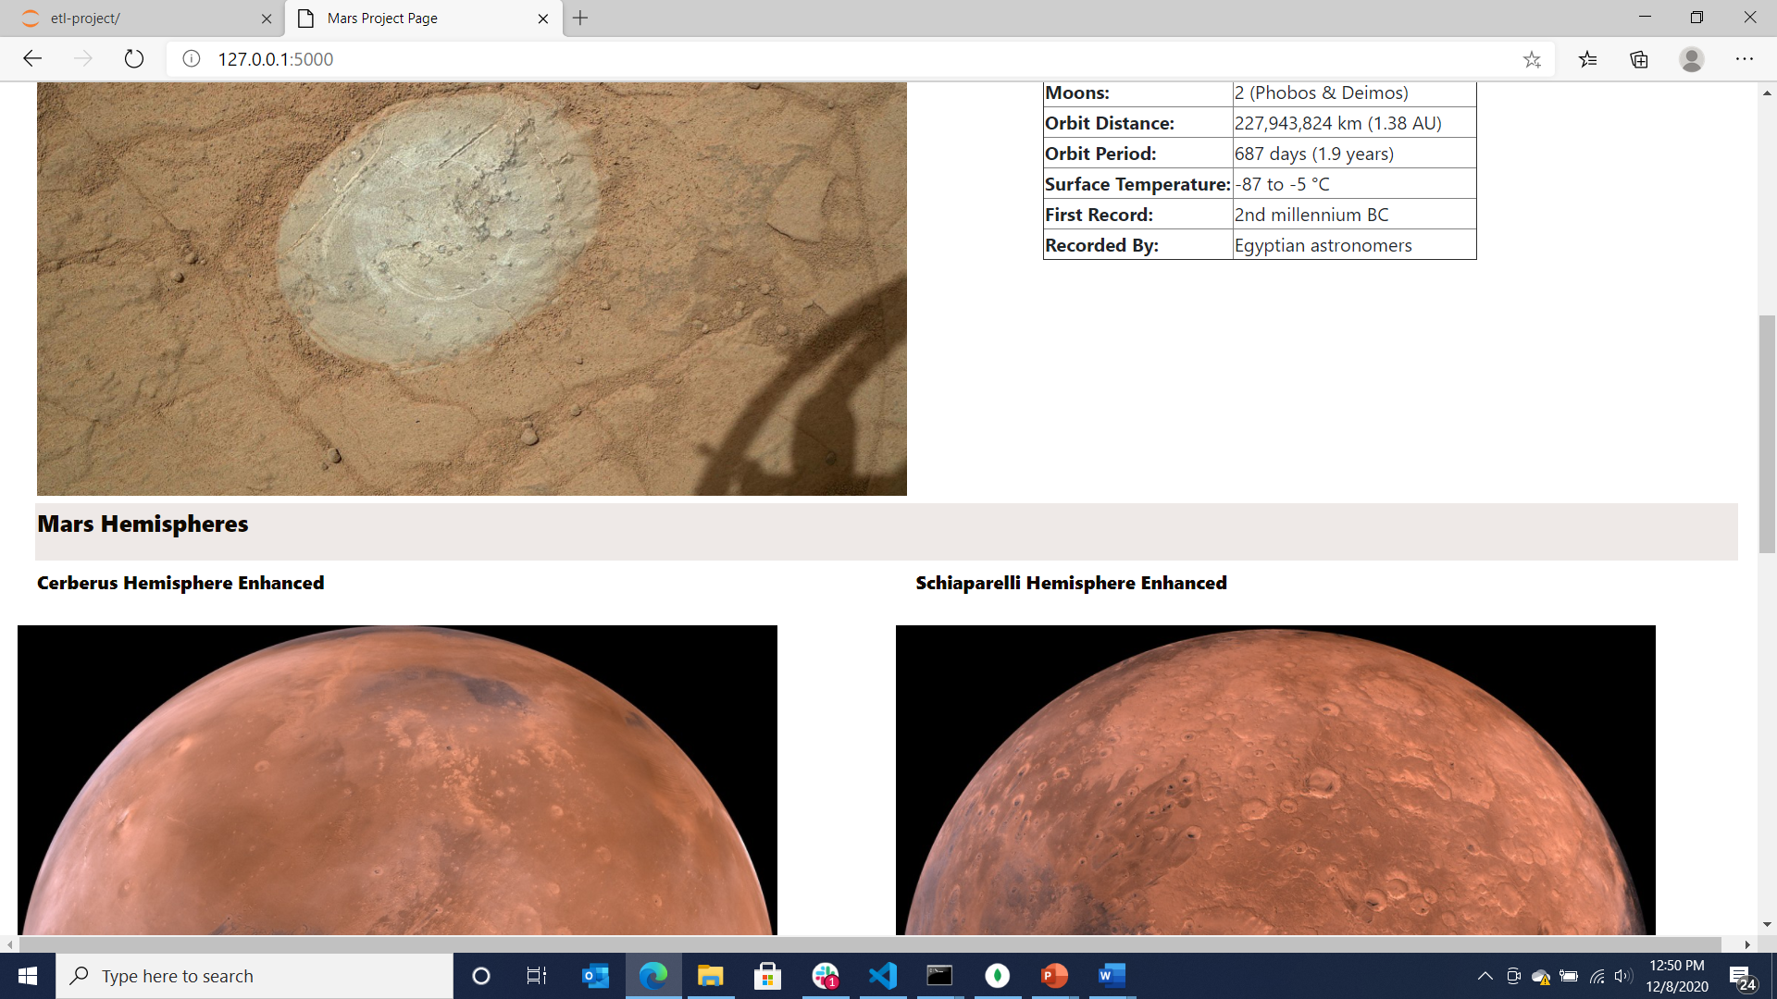

Slide 7
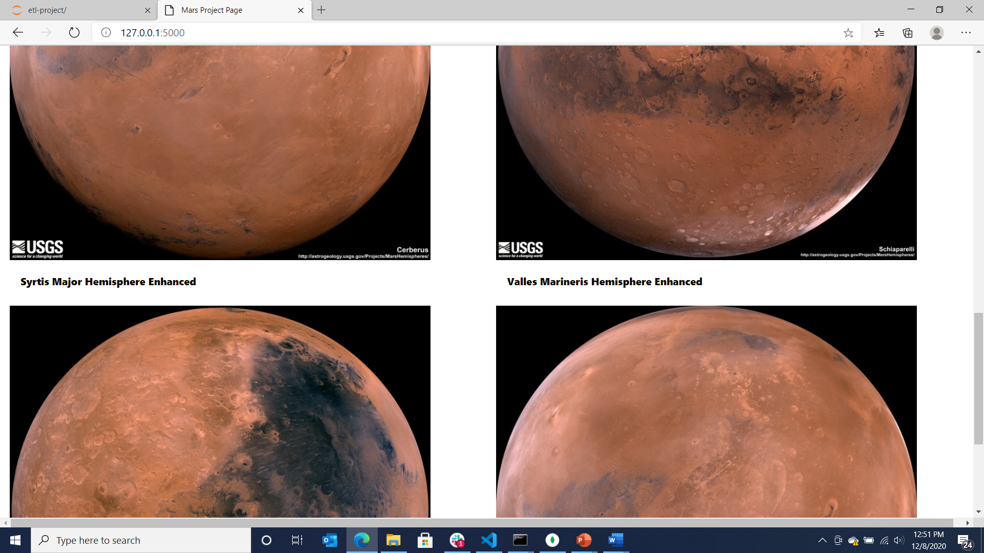

Slide 8
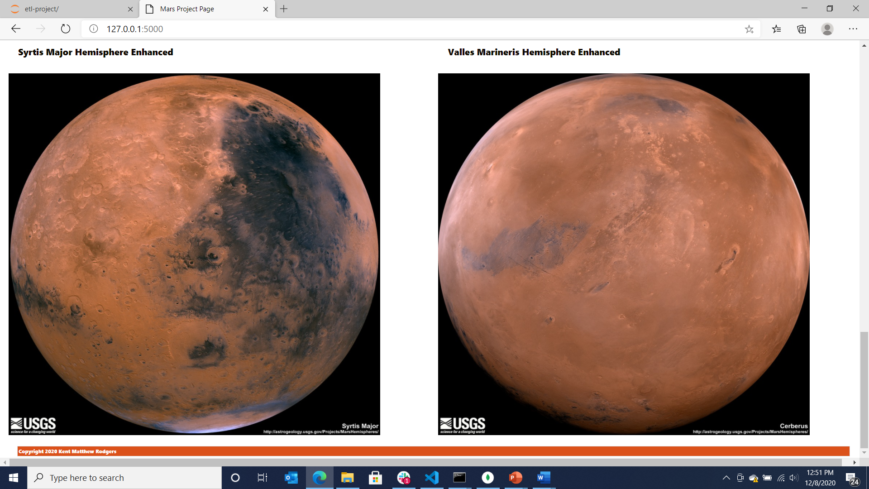

Slide 9
App.py, index.html, scrape

Slide 10
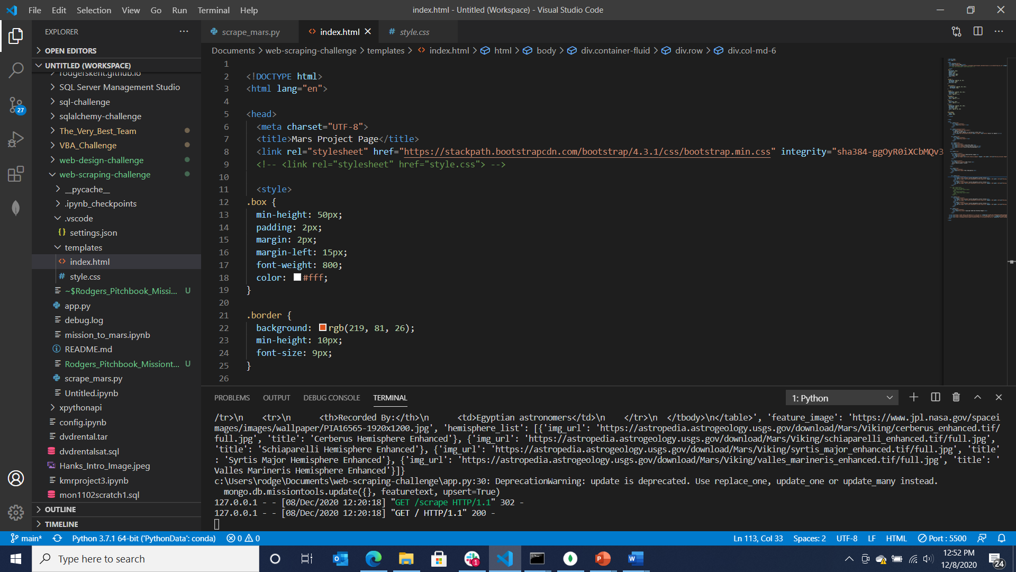
Home Page

Slide 11
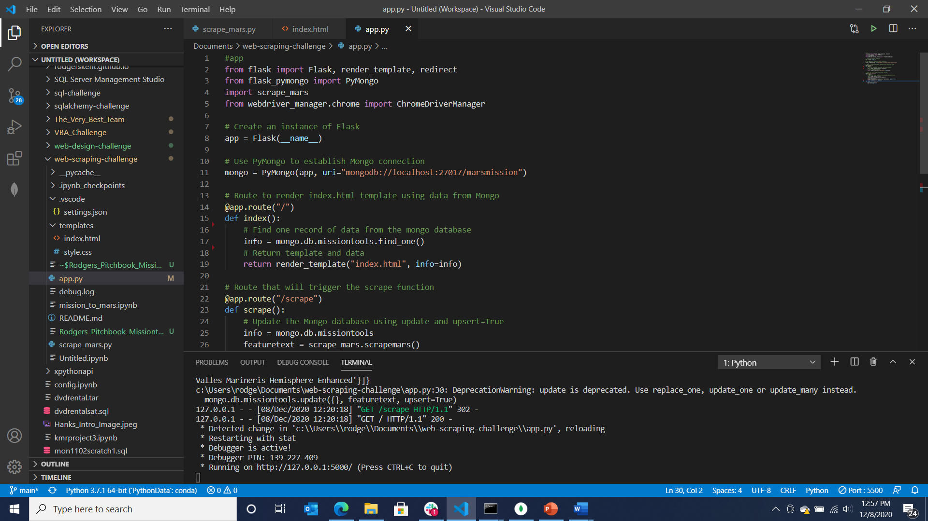

Slide 12
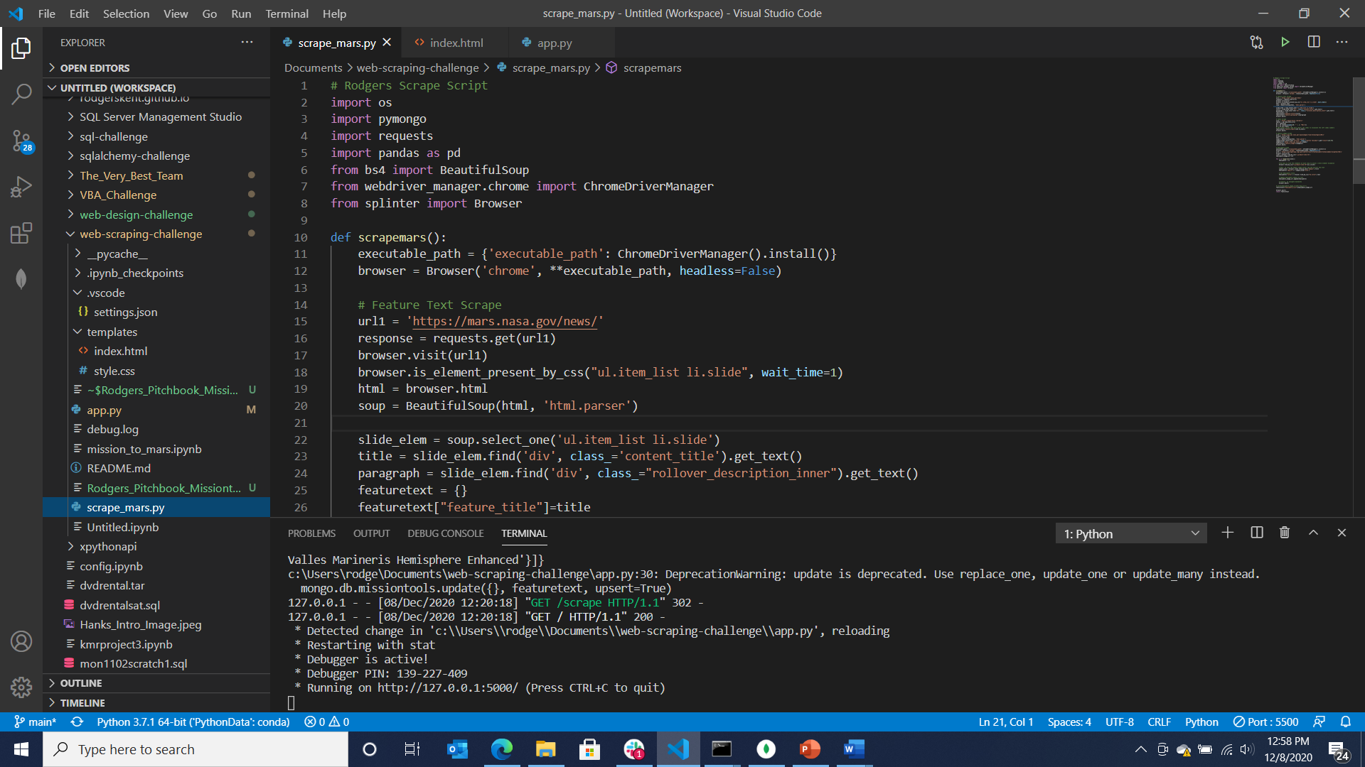

Slide 13
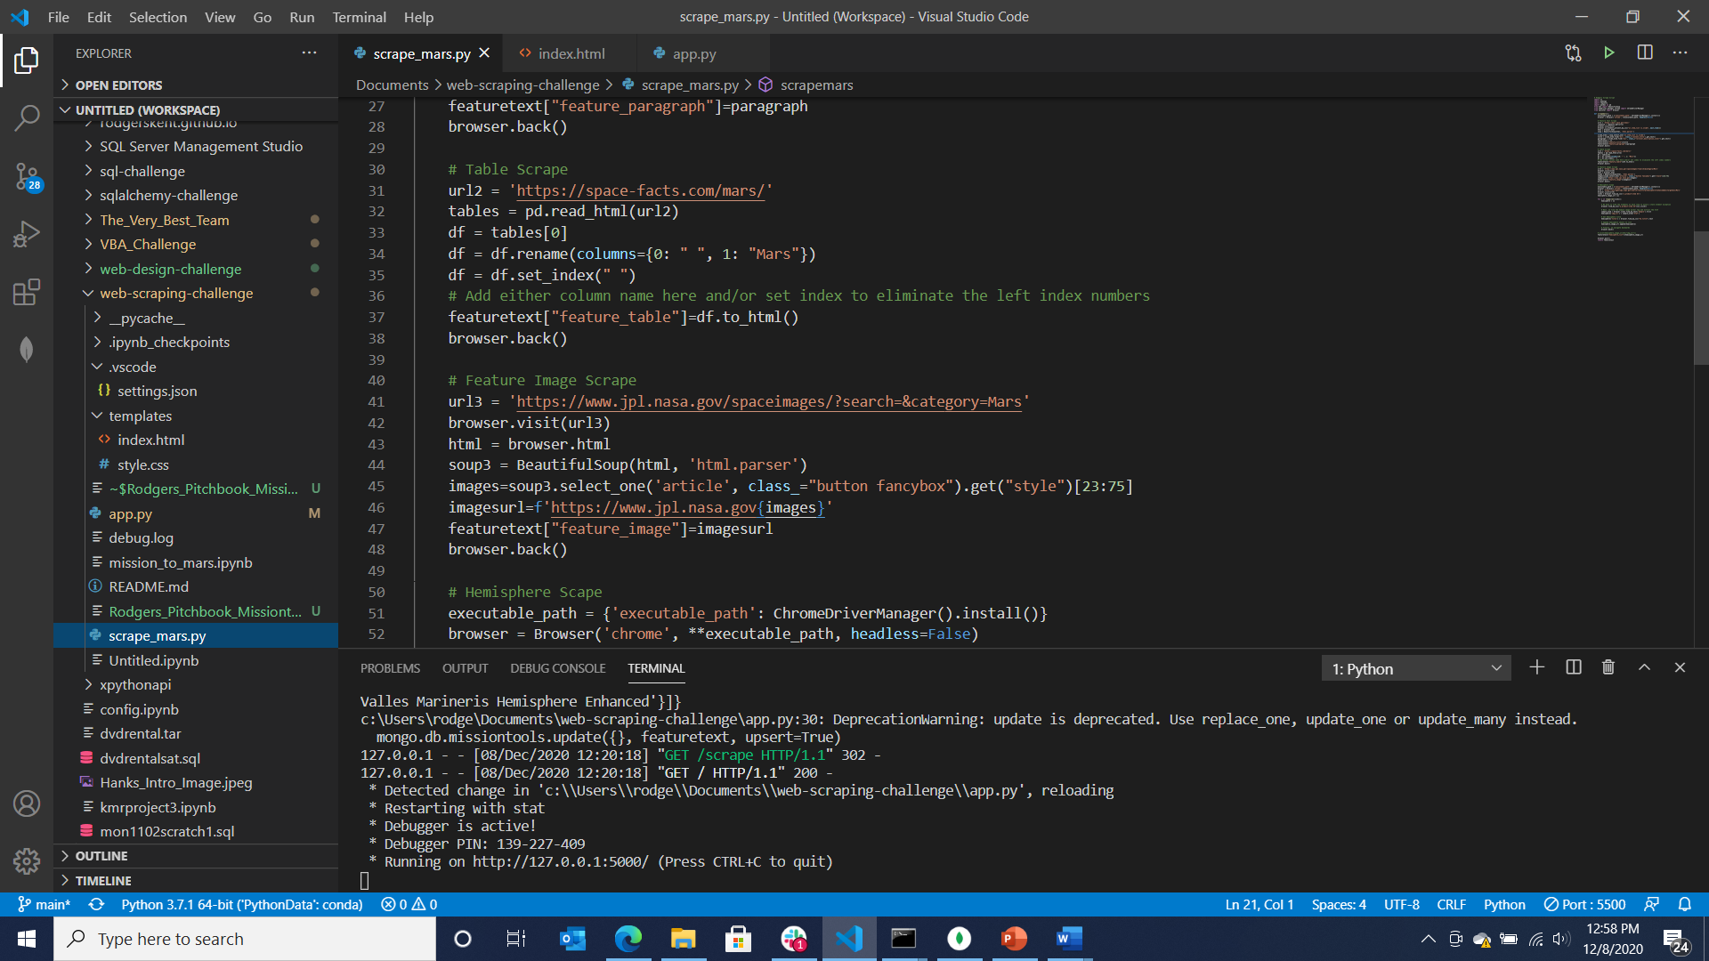

Slide 14
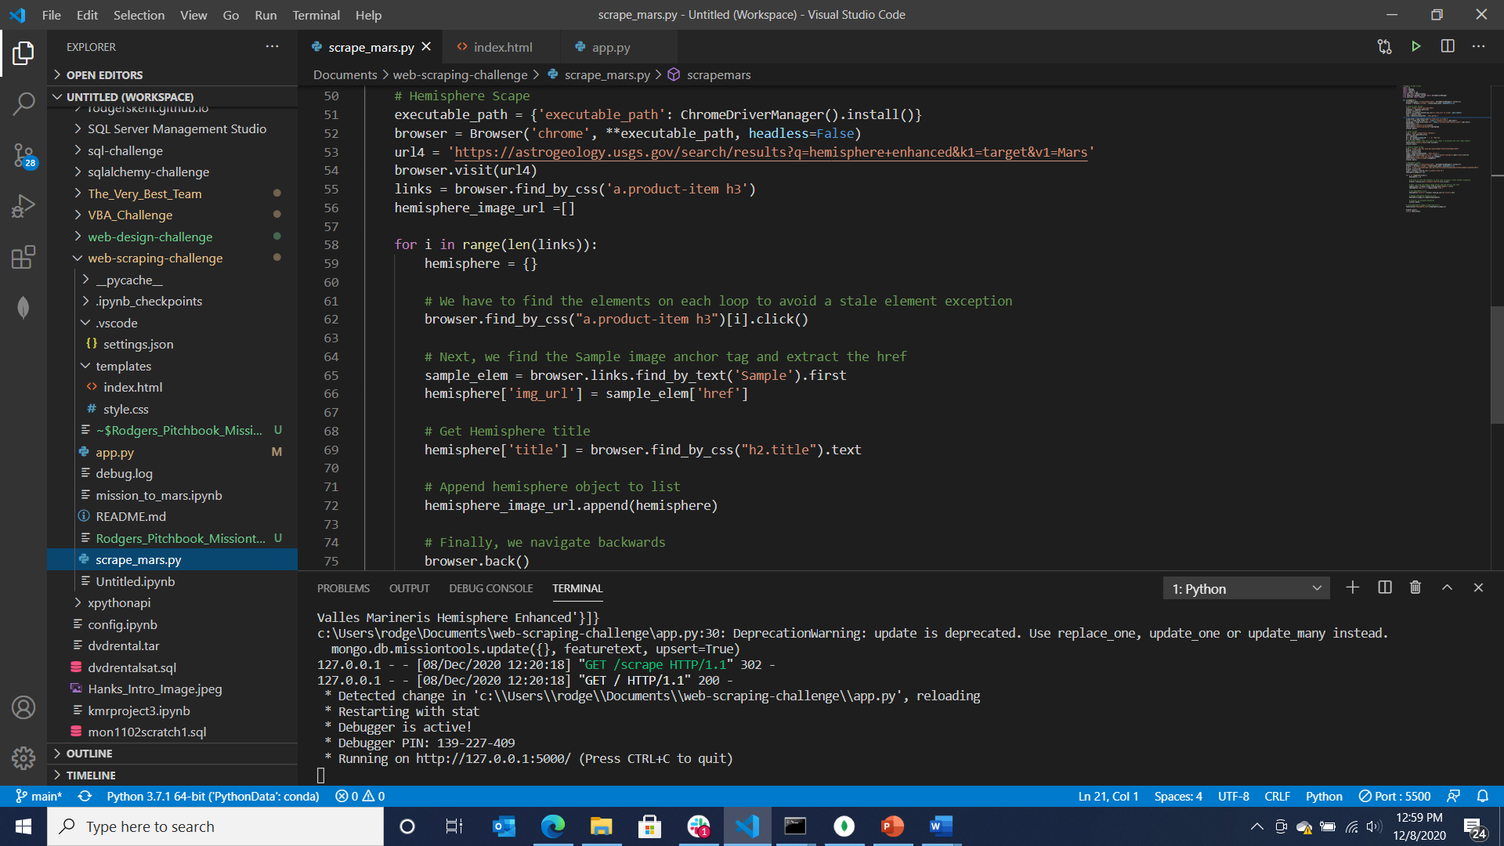

Slide 15
Websites

Slide 16
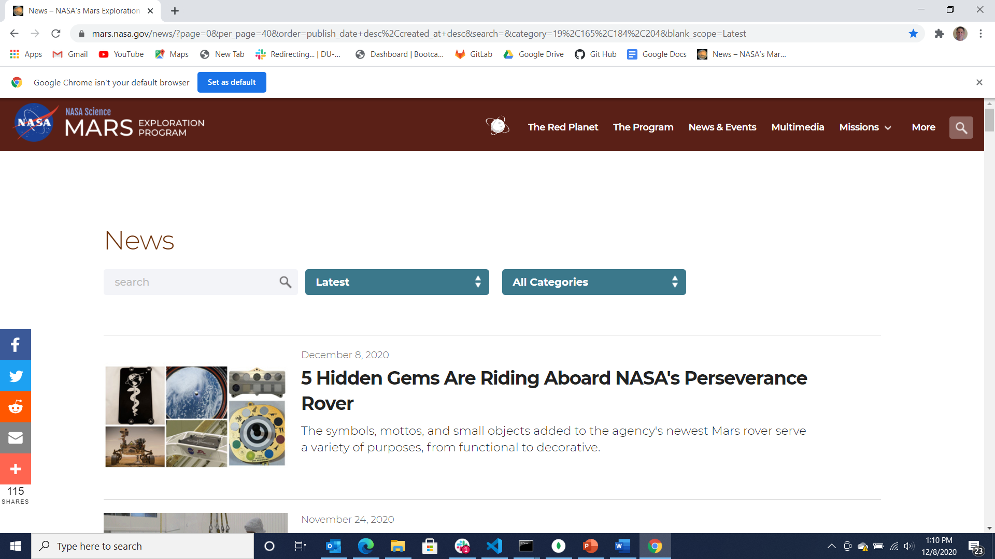

Slide 17
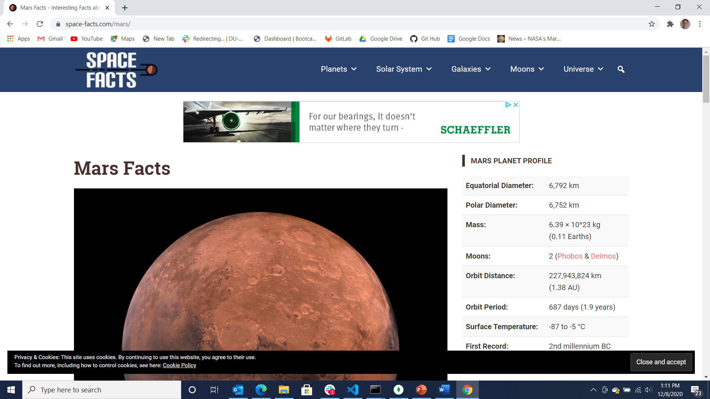

Slide 18
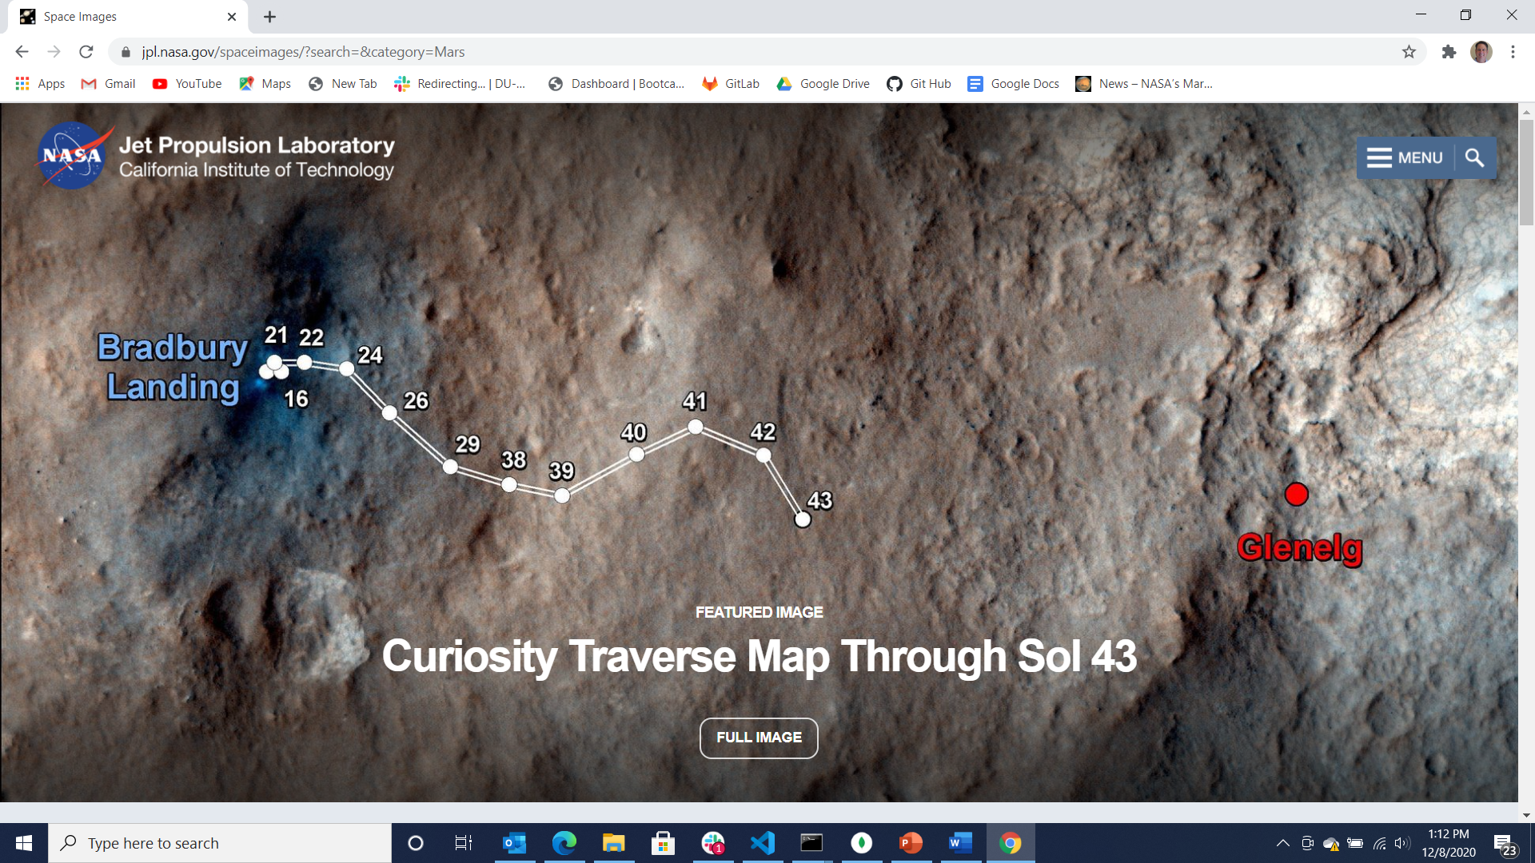

Slide 19
